Slide 1
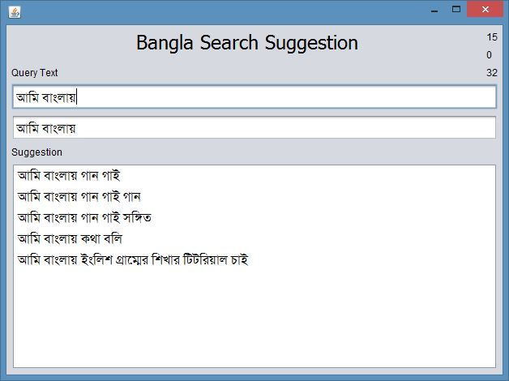
Query Auto Completion

Slide 2
Query Auto Completion
Problems
Huge amount of query needs to be stored and processed each day.
Weight of a query changes dynamically from time to time thus the ability to detect such changes.
Auto Completion needs to be done almost instantly.
Relevant and accurate information needs to be retrieved

Slide 3
Compressed Trie :Possible Solution
Same as Normal Trie
Removes redundant nodes
Each Node must have at least 2 child

Slide 4
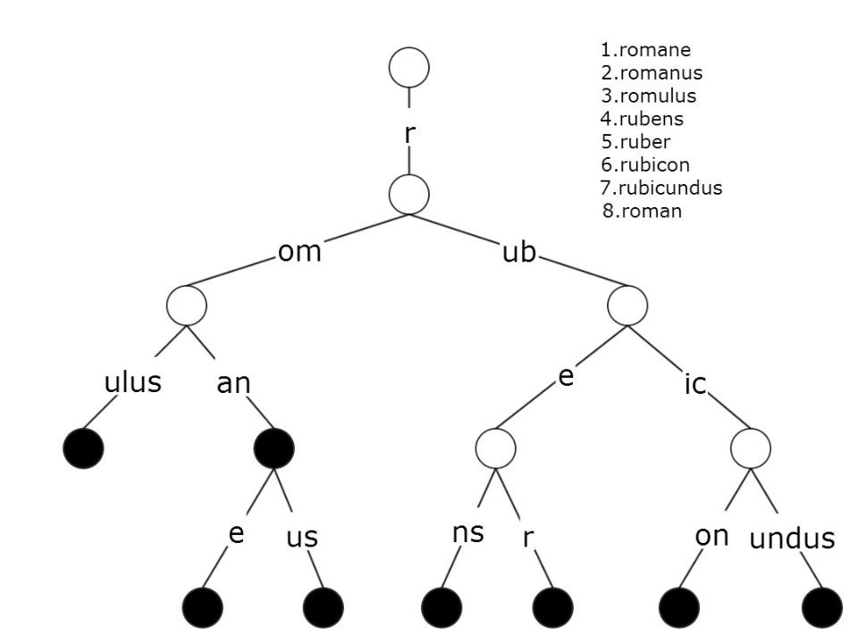
Compressed Trie :Possible Solution

Slide 5
Compressed Trie: Properties
Prefix matching is extremely fast
Insert and Delete operation is fast
Weighted Information Retrieval
Dynamic Weight change can be tracked

Slide 6
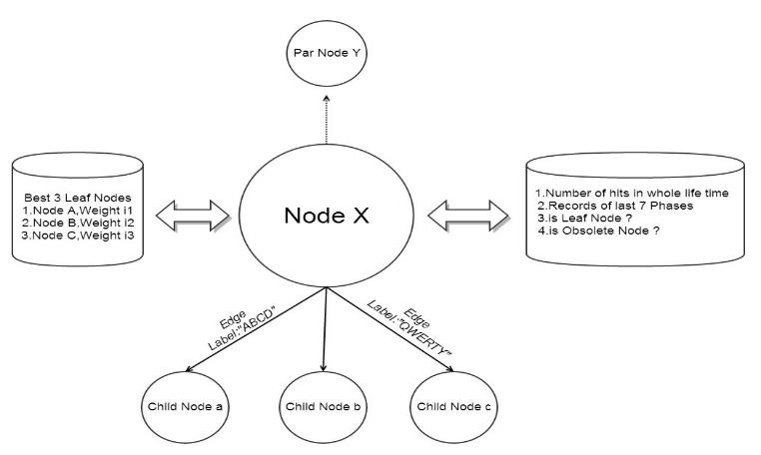
Structure of a Node

Slide 7
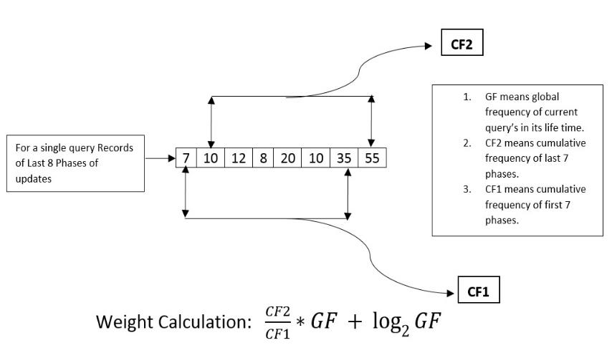
Weight Calculation of a Node

Slide 8
Compressed Trie: Example
Query Sentence | Weight
কিভাবে_ইন্টারনেট_হ্যাক_করা_যায়_ফ্রী_চালানোর_জন্য | ৫৫
কিভাবে_ইন্টারনেট_এর_গতি_বাড়াবো | ৮
কিভাবে_ইন্টারনেটের_মাধ্যমে_আয়_করব | ৬
কিভাবে_ইন্টারনেটের_গতি_বাড়ান_যায় | ৪
আমি_বাংলায়_গান_গাই | ৫০
আমি_বাংলায়_গান_গাই_গান | ৩০
আমি_বাংলায়_গান_গাই_সঙ্গীত | ১৫
আমি_বাংলায়_কথা_বলি | ১০
আমি_বাংলায়_চিঠি_লিখি | ৬

Slide 9
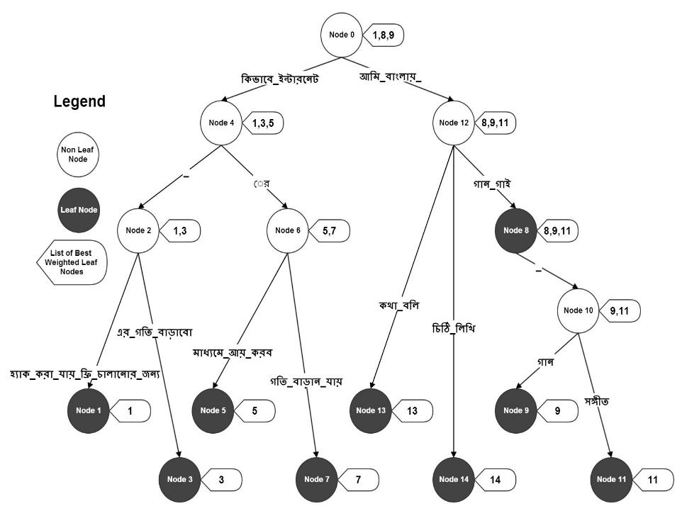
Compressed Trie: Example

Slide 10
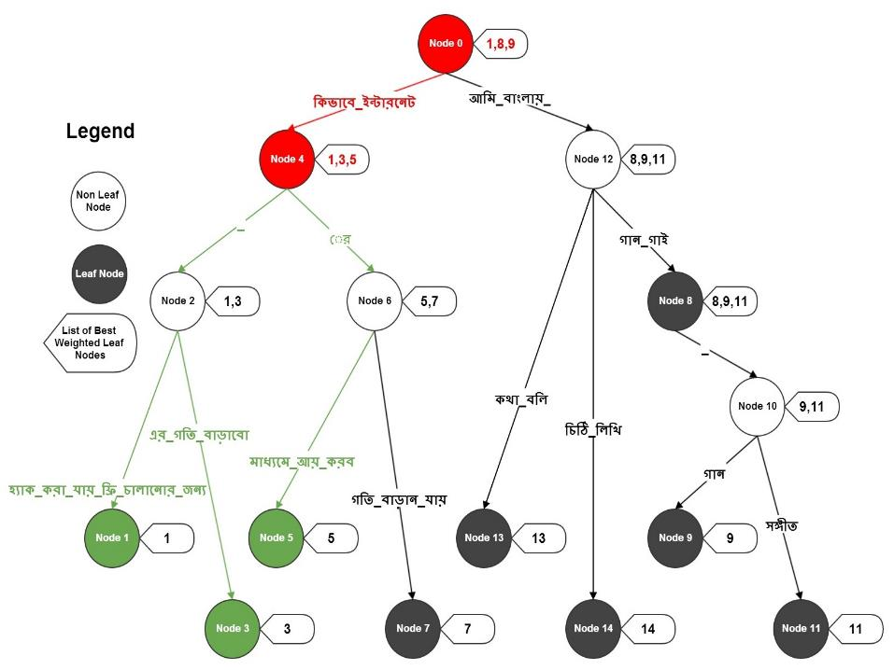
Compressed Trie: Properties

Slide 11
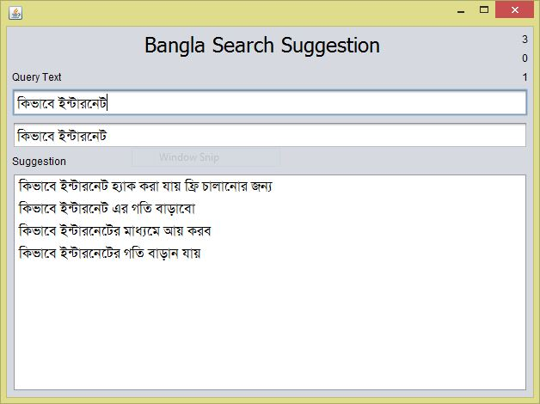
Compressed Trie: Results

Slide 12
Compressed Trie: Performance
Memory Usage : For each unique query string there are atmost 2 nodes needed ( Worst Case )
Complexity Analysis : For each user’s query the only time spent is scanning that string and rest of the process has constant time complexity O(1)

Slide 13
Compressed Trie: Future Work
Personalized Query Auto Completion
Storing the tree in distributed system
Zero query search suggestion

